Slide 1
The landscape of prevalence and surveillance of climate sensitive vector-borne diseases in Africa
Houriiyah Tegally, Monika Moir, Tulio de Oliveira
Centre for Epidemic Response and Innovation (CERI)
CLIMADE-Africa
(Preliminary)

Slide 2
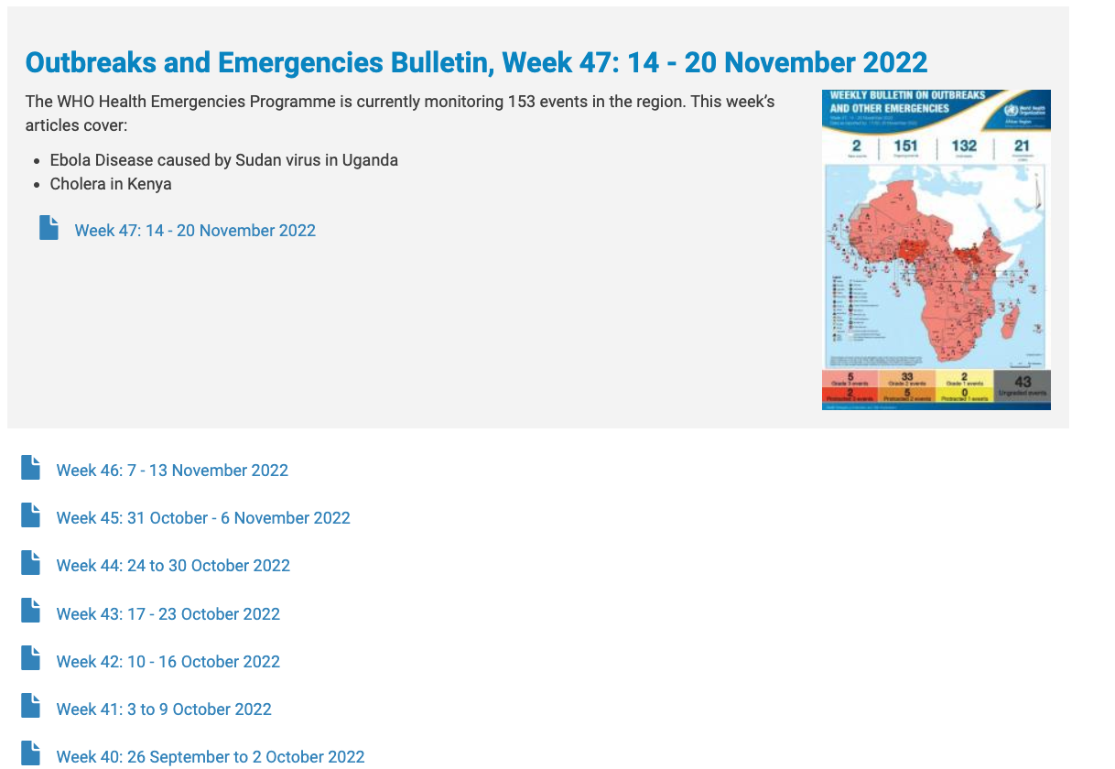
Sourcing Prevalence Information (Disease Occurrence/Outbreaks)
1. WHO Afro outbreak reports

Slide 3
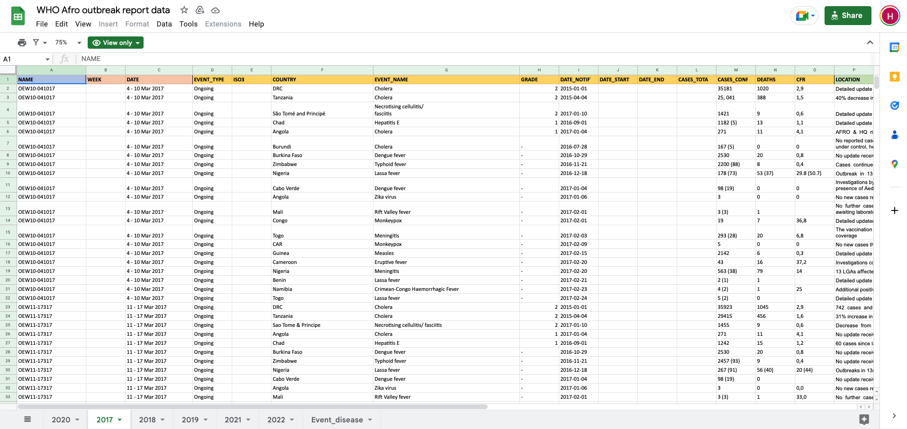
Sourcing Prevalence Information (Disease Occurrence/Outbreaks)
1. WHO Afro outbreak reports

Slide 4
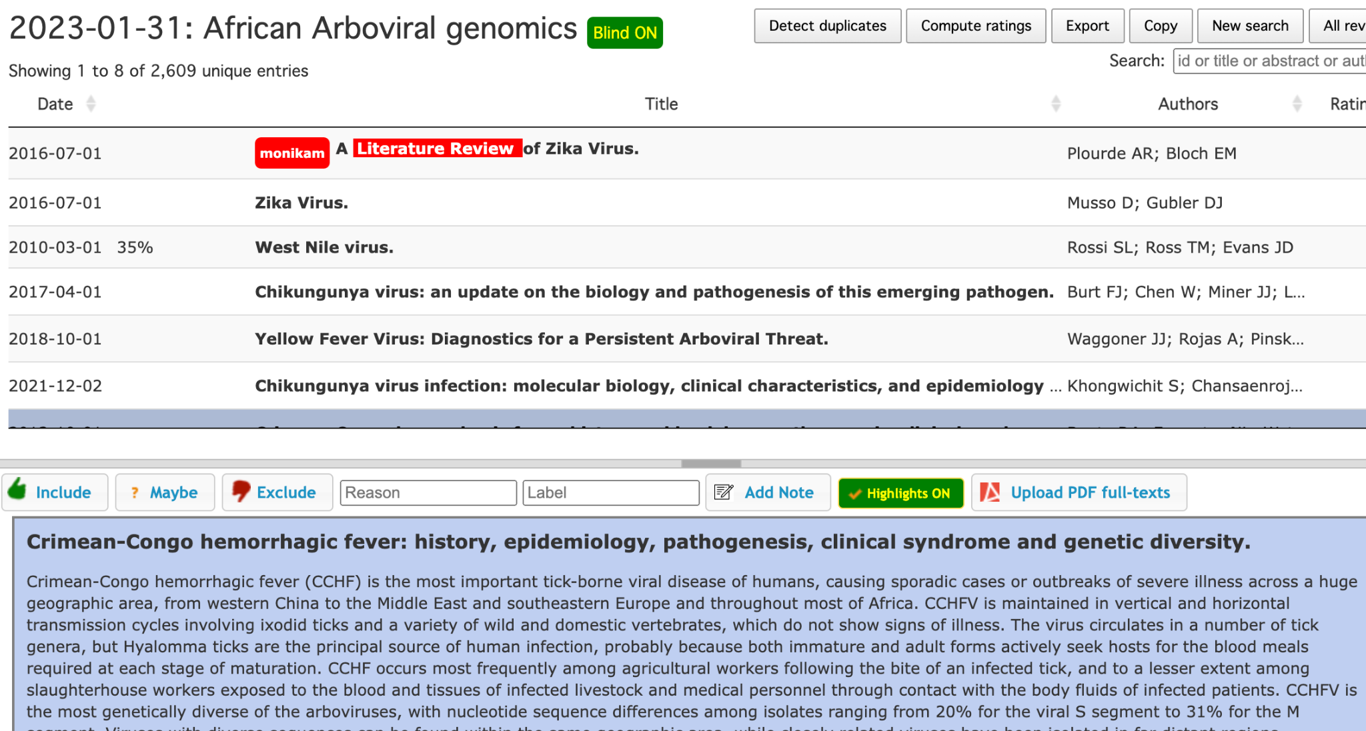
Sourcing Prevalence Information (Genomics + Seroprevalence)
2. Published Scientific Literature (Screening publications from broad pubmed search)
3. Individual engagement with public health offices and scientists
To obtain information not published in scientific literature and potentially not captured in WHO reports

Slide 5
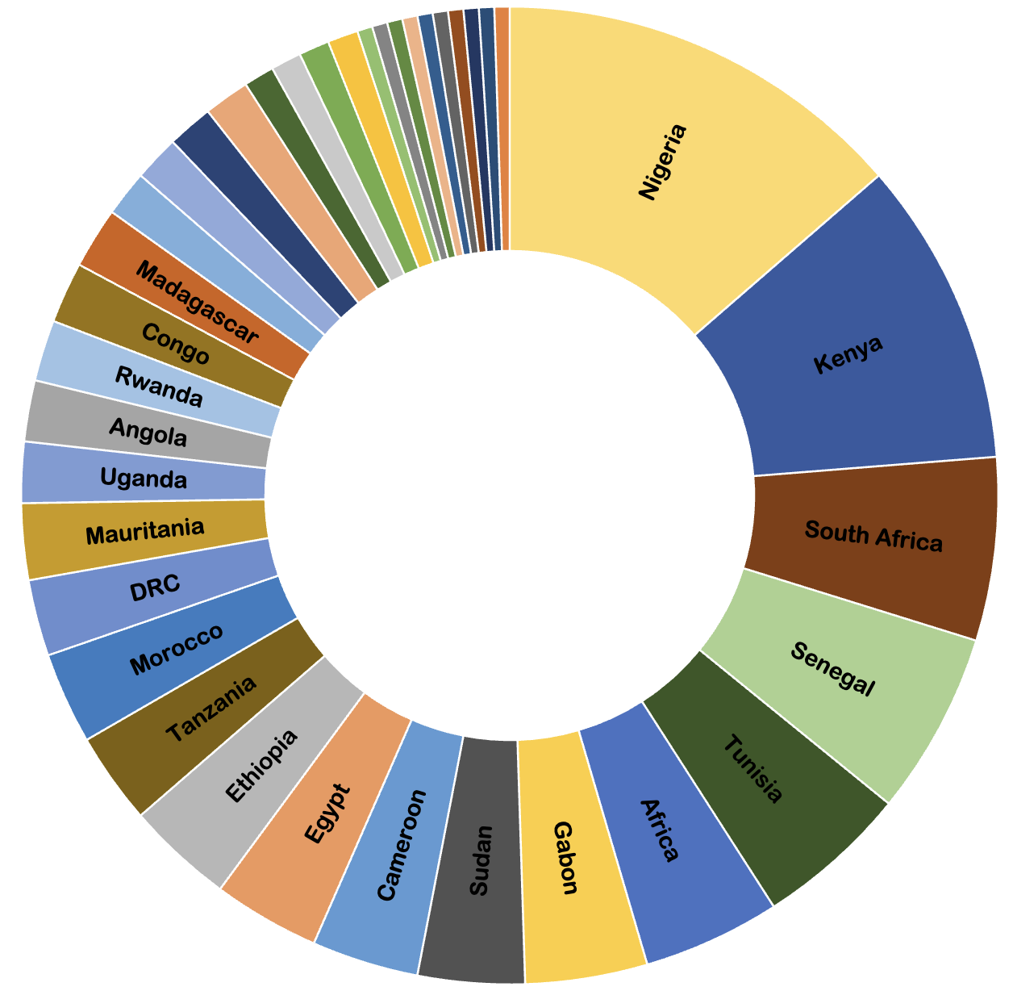
Initial results for 634 papers of systematic review
Fig. African countries ranked in order of greatest proportion of arboviral surveillance and outbreak response studies

Slide 6
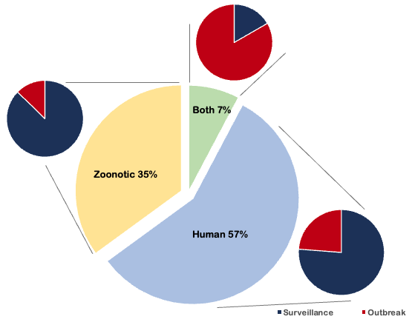
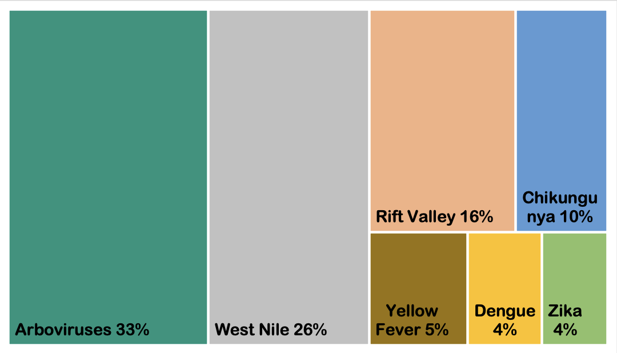

Initial results for 634 papers included in systematic review
Fig. Tree map displaying the percentage of the six main arboviruses of concern investigated in the screened studies. Studies that encompasses multiple viruses were grouped as ‘Arboviruses’.
Fig. The considered studies were categorised based on whether subjects were humans, animals or both; and whether the study was in response to an outbreak or routine/surveillance effort.

Slide 7
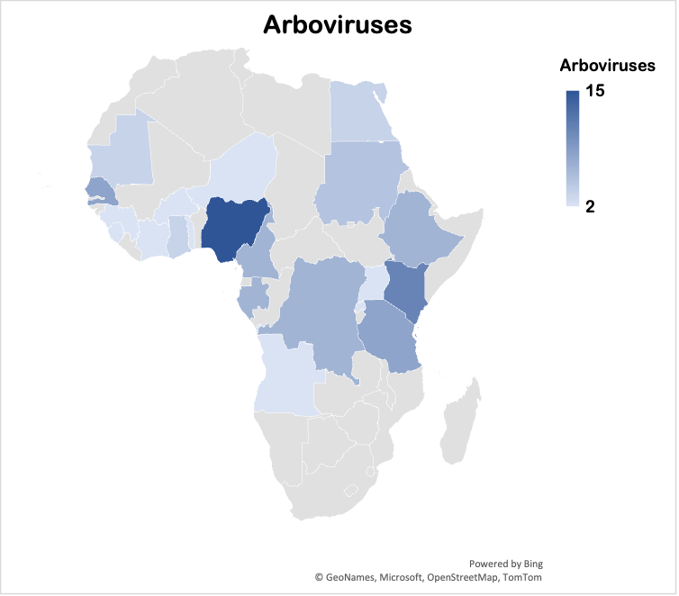
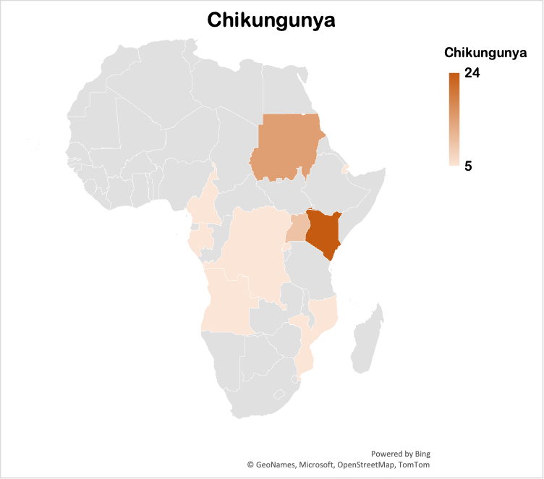
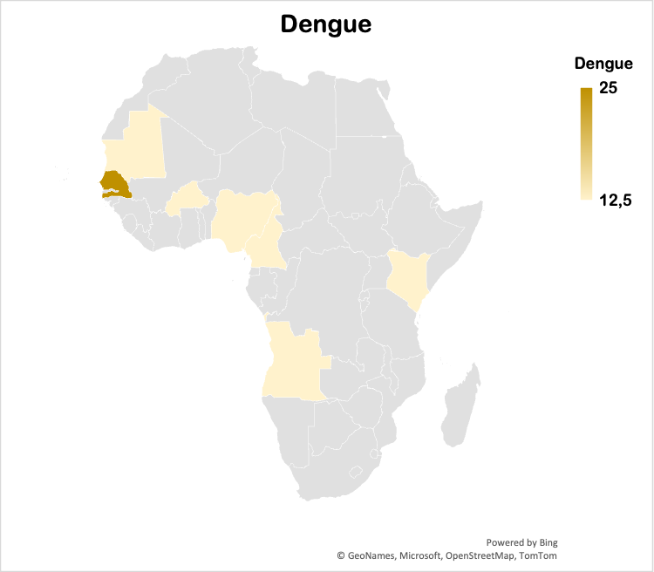
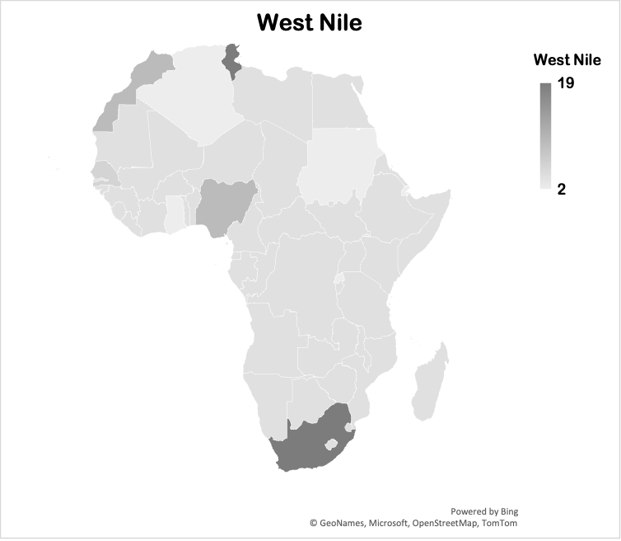
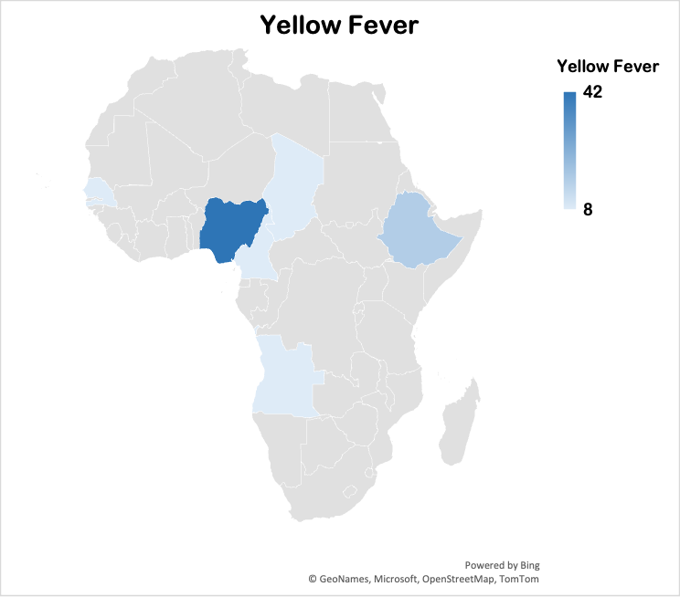
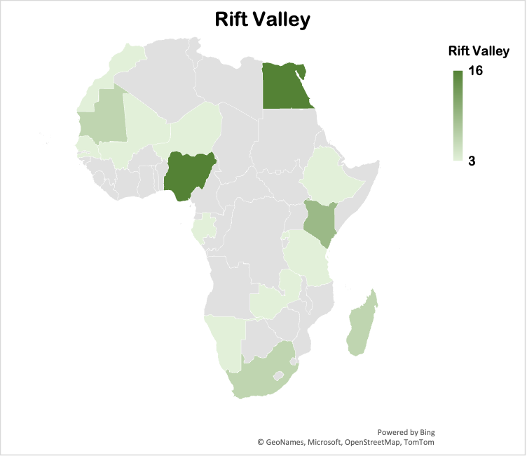
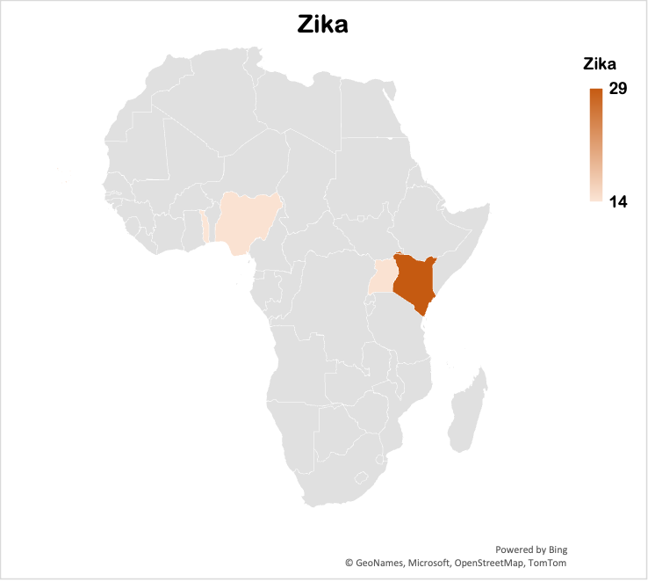
Percent of studies per African country

Slide 8
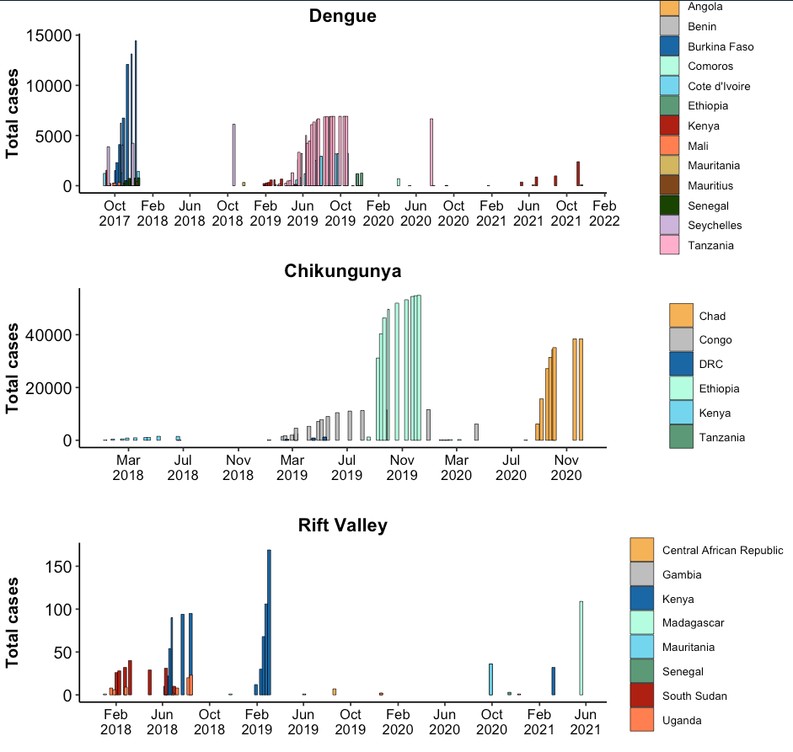
Total cases from WHO Afro outbreak reports

Slide 9
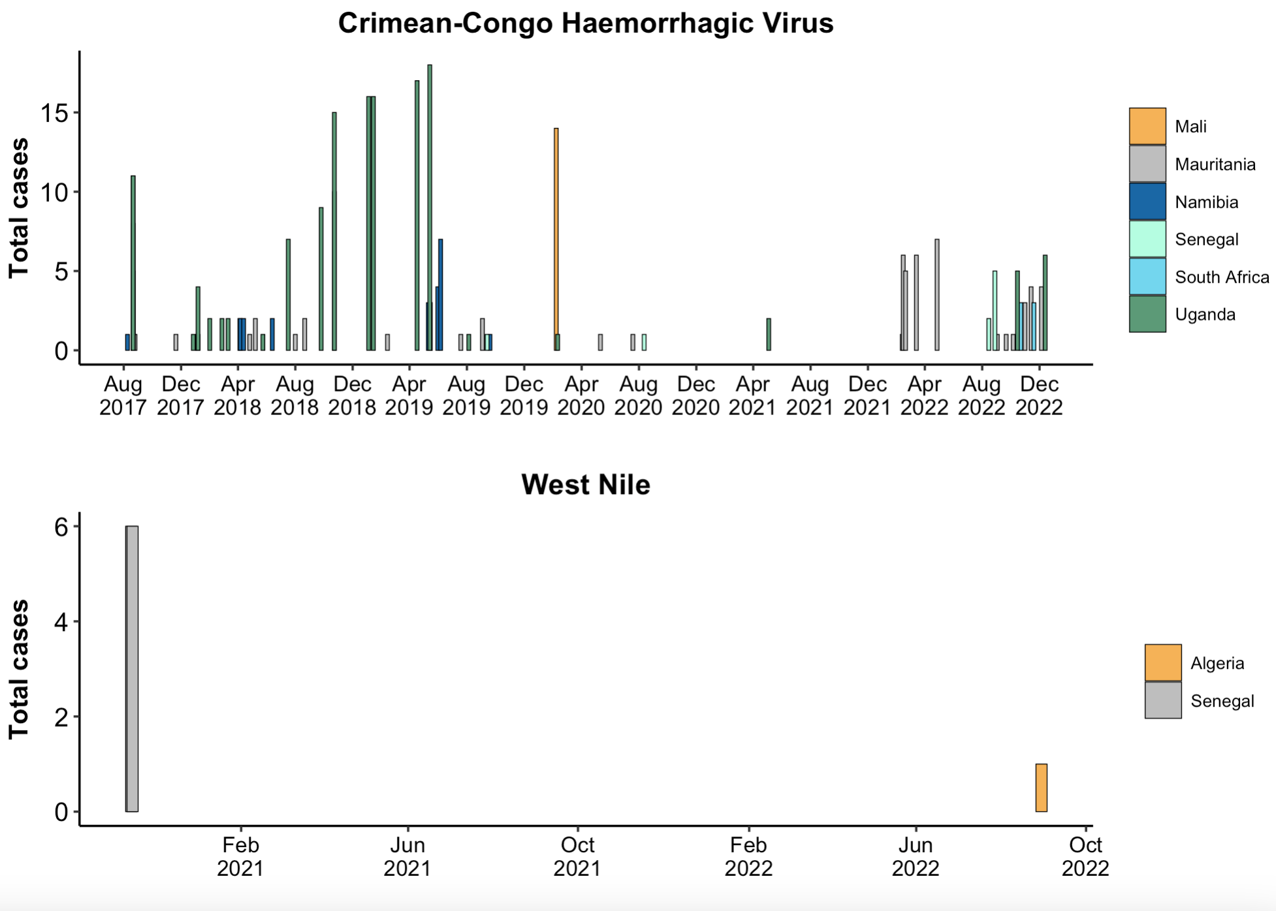
Total cases from WHO Afro outbreak reports

Slide 10
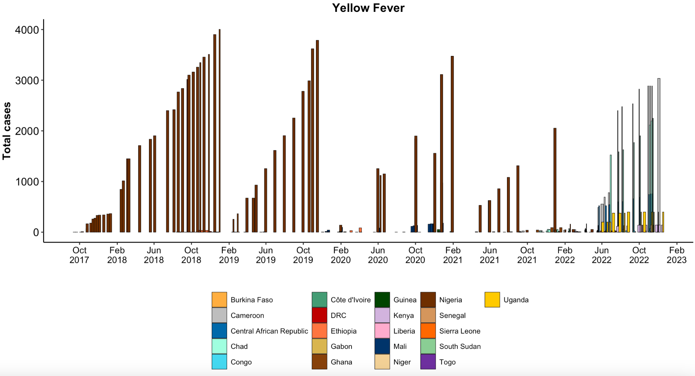
Total cases from WHO Afro outbreak reports

Slide 11
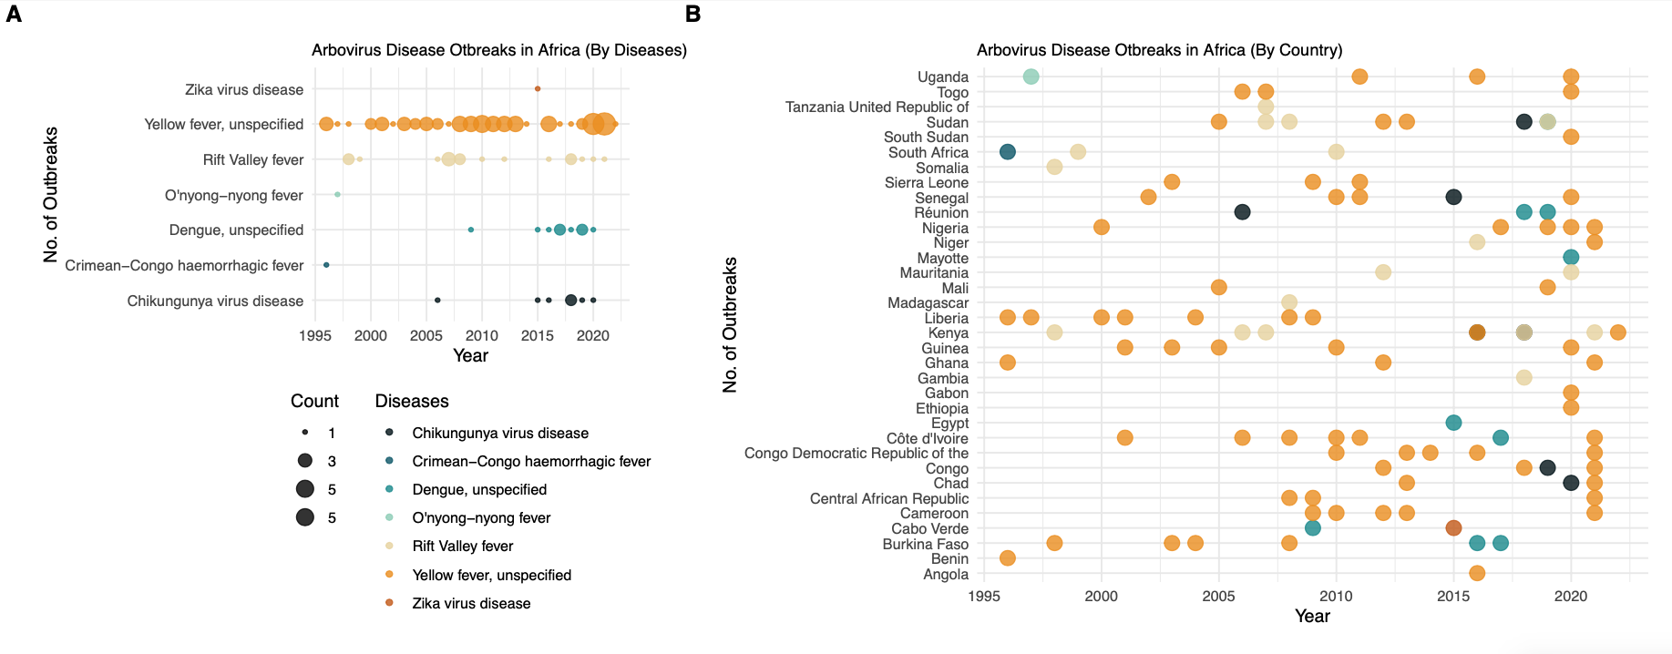
Outbreak notifications

Slide 12
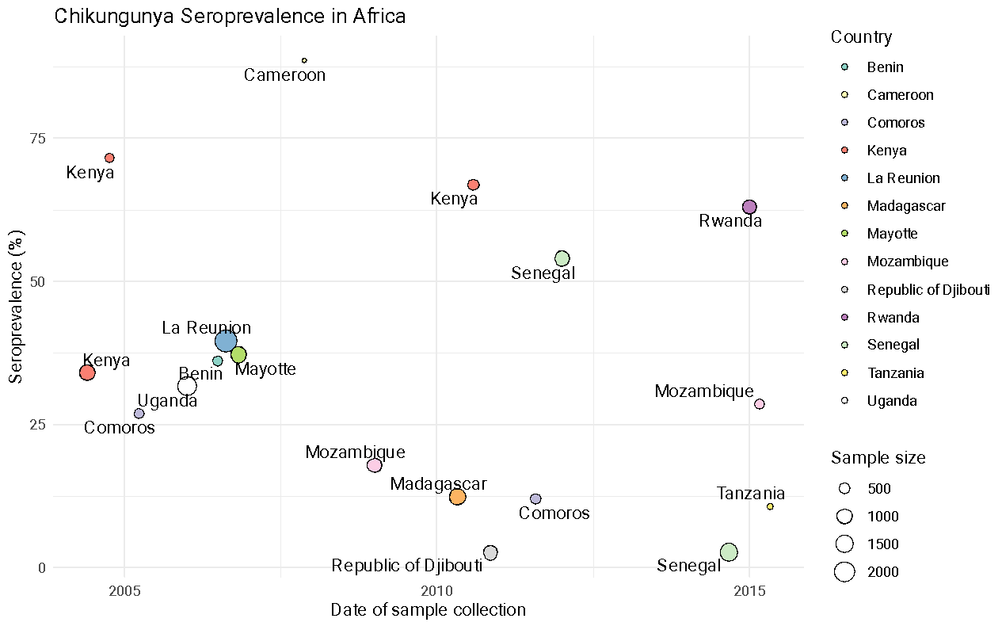
Seroprevalence surveys (e.g. Chikungunya)
Chikungunya 1999-2020 (doi: 10.1371/journal.pntd.0010069)

Slide 13
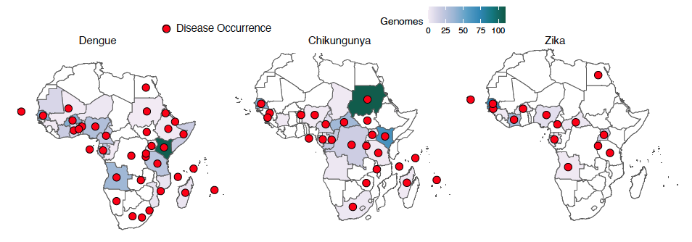
The landscape of genomic surveillance of arboviruses in Africa
Genomic vs Disease Surveillance

Slide 14


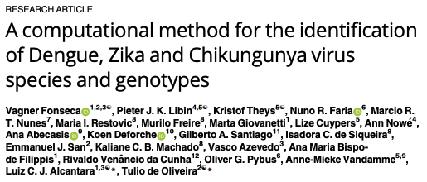
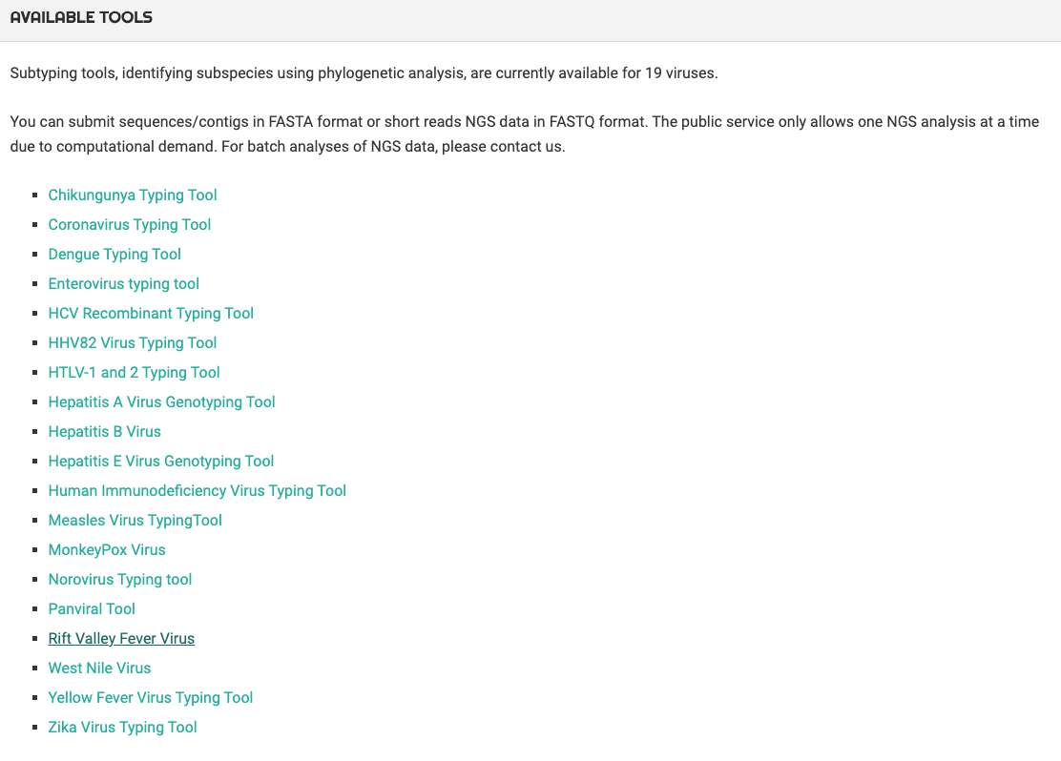
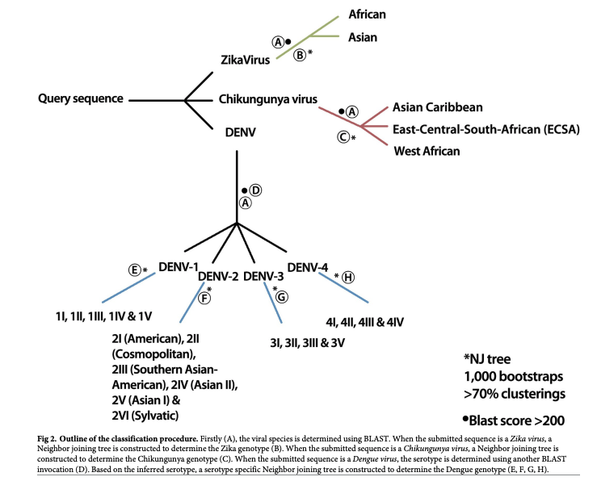
The landscape of genomic surveillance of arboviruses in Africa
Typing arbovirus genomes
10.1186/s12864-022-08764-6
10.1371/journal.pntd.0007231
Tool will be extended for Crimean-Congo Hemorrhagic Fever

Slide 15
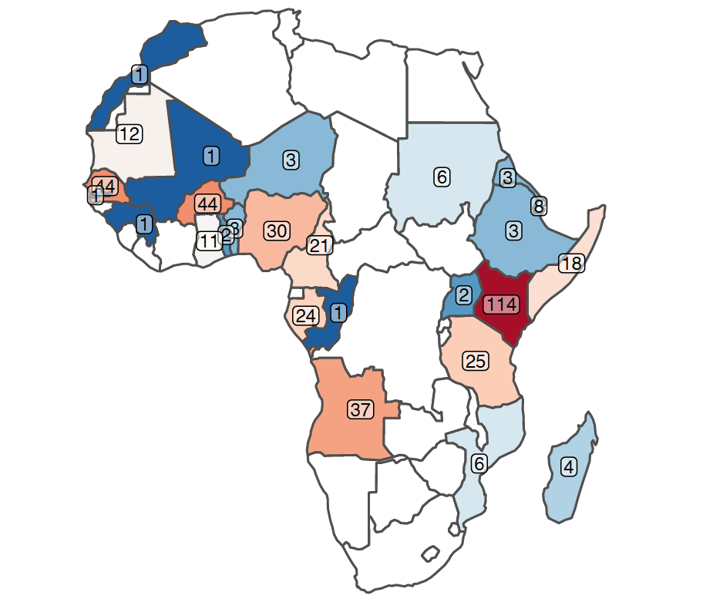
The landscape of genomic surveillance of arboviruses in Africa
Dengue
Africa:
genomes = 457
countries = 30
1953-2021
Quality:
Coverage >90% = 215
Genotyped = 208

Slide 16
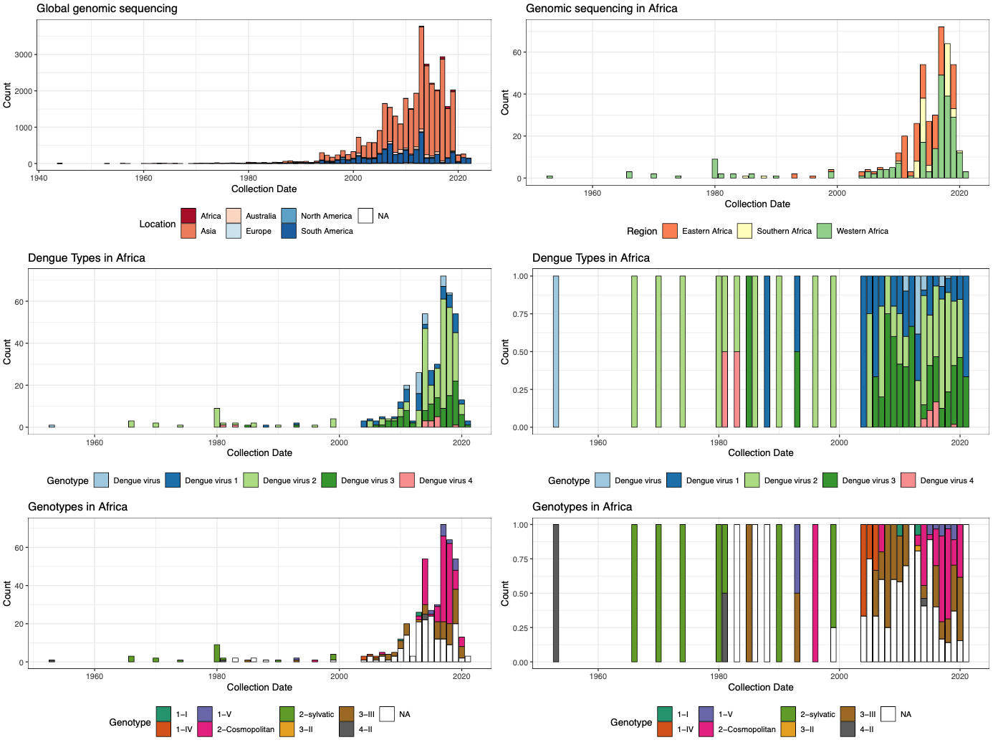
The landscape of genomic surveillance of arboviruses in Africa
Dengue
Africa:
genomes = 457
countries = 30
1953-2021
Quality:
Coverage >90% = 215
Genotyped = 208

Slide 17
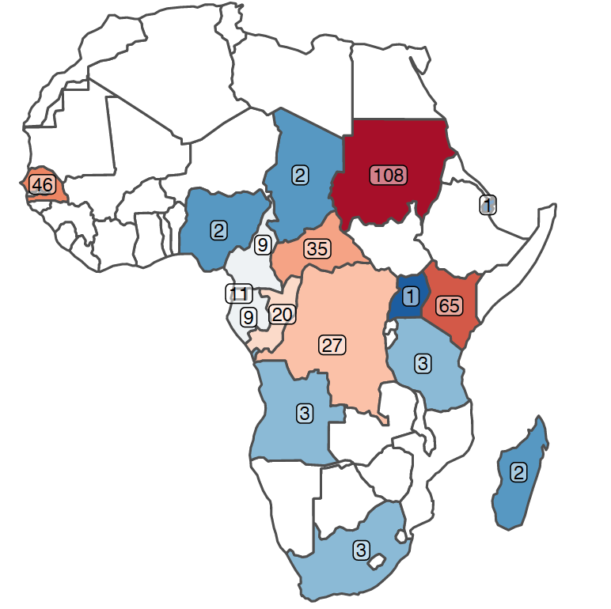
The landscape of genomic surveillance of arboviruses in Africa
Chikungunya
Africa:
genomes = 372
countries = 21
1953-2021
Quality:
Coverage >90% = 316
Genotyped = 724

Slide 18
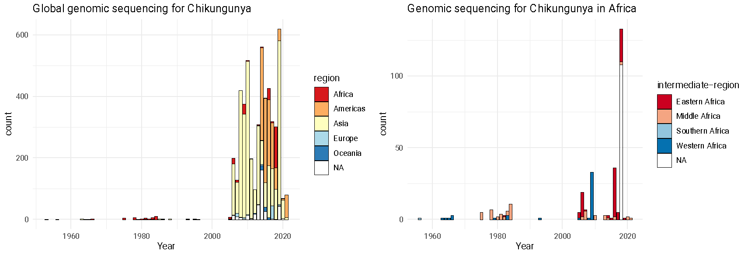
The landscape of genomic surveillance of arboviruses in Africa
Chikungunya
Africa:
genomes = 372
countries = 21
1953-2021
Quality:
Coverage >90% = 316
Genotyped = 724
Asian and Caribbean = 0
East-Central-South-African = 626
West African = 98

Slide 19
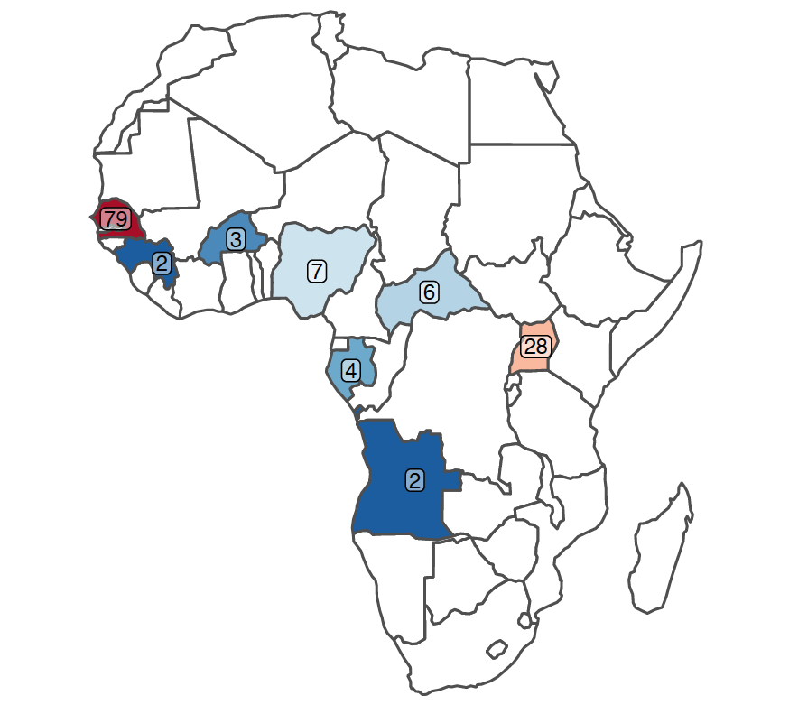
The landscape of genomic surveillance of arboviruses in Africa
Zika
Africa:
genomes = 167
countries = 10
1947-2021
Quality:
Coverage >90% = 47
Genotyped = 150

Slide 20
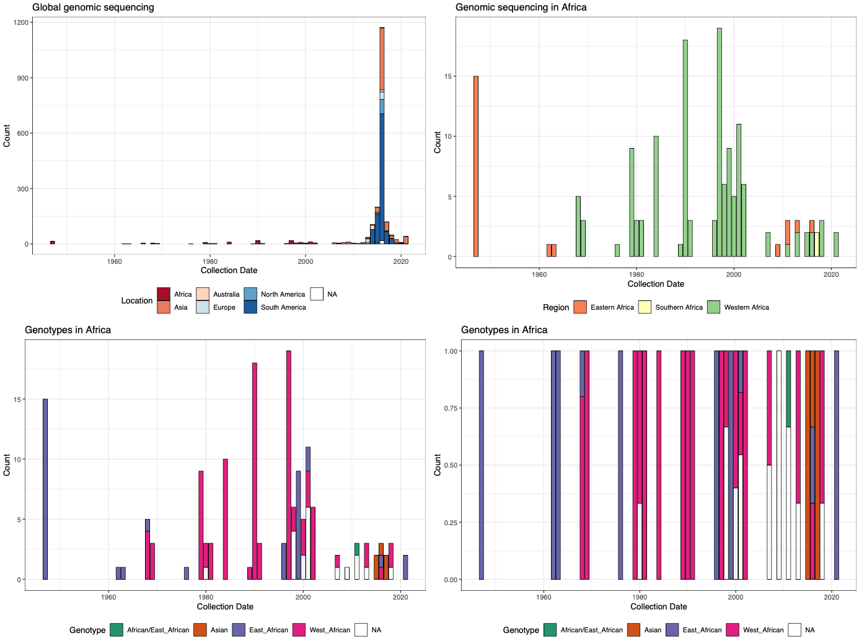
The landscape of genomic surveillance of arboviruses in Africa
Zika
Africa:
genomes = 167
countries = 10
1947-2021
Quality:
Coverage >90% = 47
Genotyped = 150

Slide 21
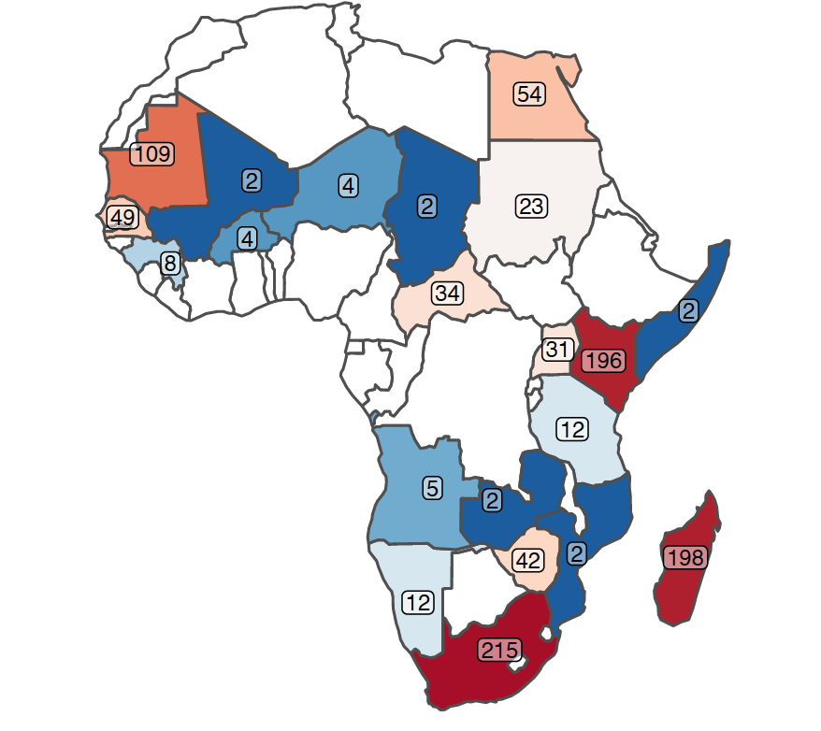
The landscape of genomic surveillance of arboviruses in Africa
Rift Valley Fever
Africa:
genomes = 1006
countries = 20
1944-2021
Quality:
Coverage >90% = 175 (3 segments different lengths)
Genotyped = 317 (Segment M only)

Slide 22
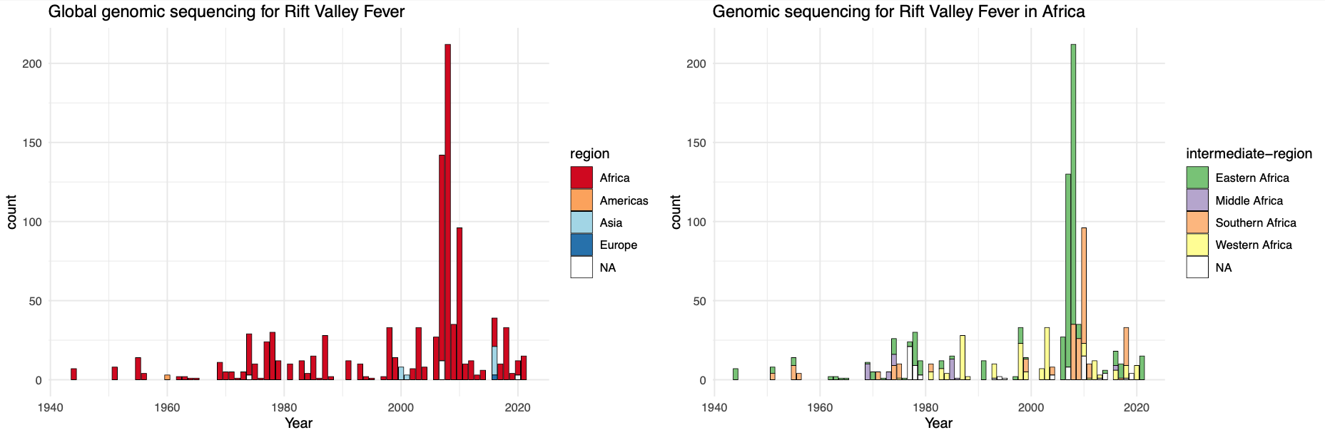
The landscape of genomic surveillance of arboviruses in Africa
Rift Valley Fever
Africa:
genomes = 1006
countries = 20
1944-2021
Quality:
Coverage >90% = 175 (3 segments different lengths)
Genotyped = 317 (Segment M only)

Slide 23
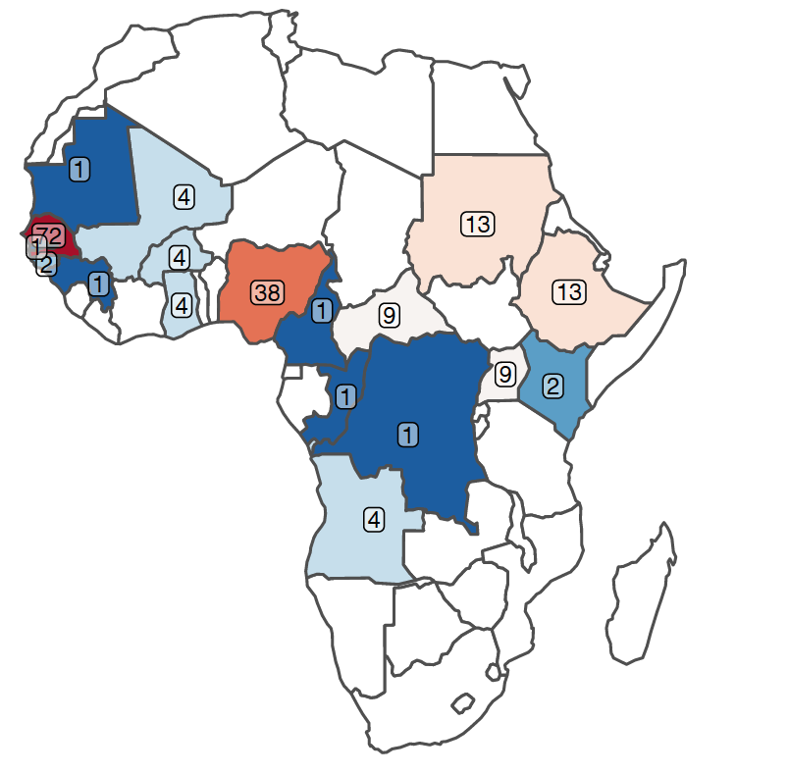
The landscape of genomic surveillance of arboviruses in Africa
Yellow Fever
Africa:
genomes = 185
countries = 17
1927-2021
Quality:
Coverage >90% = 64
Genotyped = 177

Slide 24
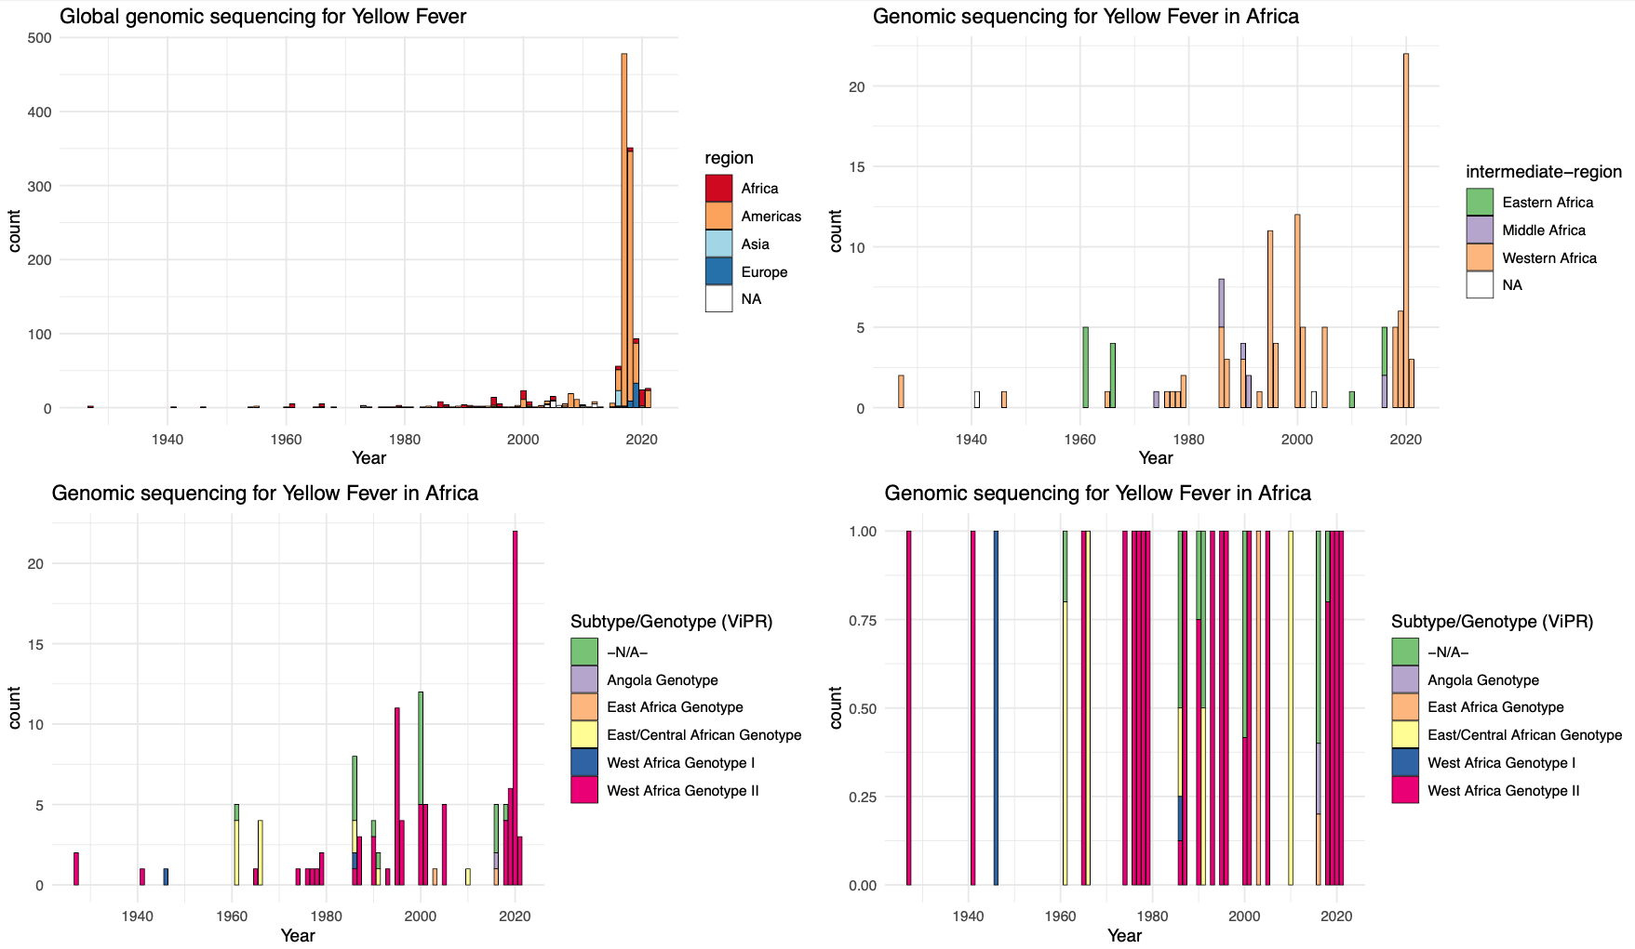
The landscape of genomic surveillance of arboviruses in Africa
Yellow Fever
Africa:
genomes = 185
countries = 17
1927-2021
Quality:
Coverage >90% = 64
Genotyped = 177

Slide 25
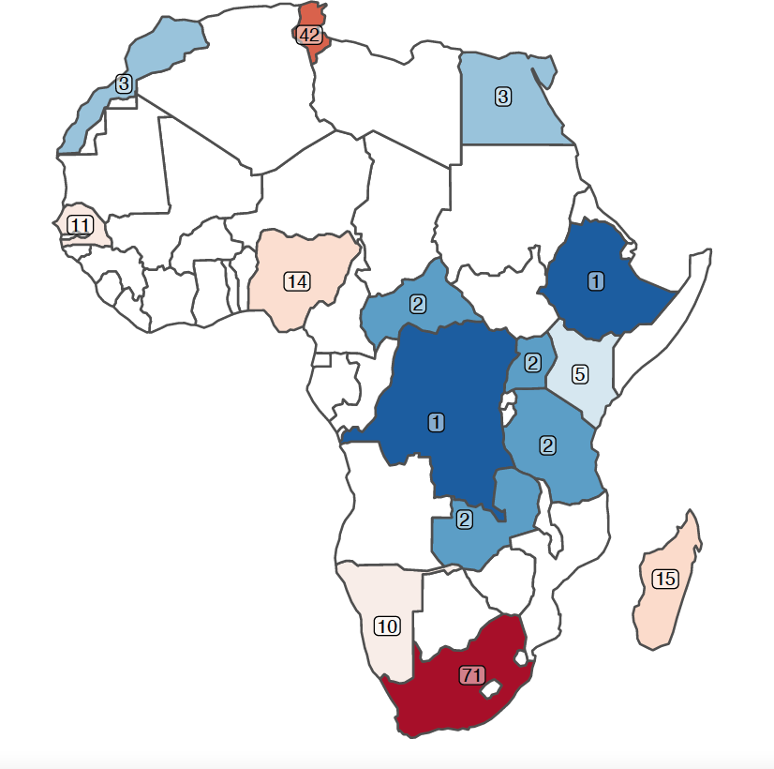
The landscape of genomic surveillance of arboviruses in Africa
West Nile Fever
Africa:
genomes = 181
countries = 15
1958-2020
Quality:
Coverage >90% = 29
Genotyped = 167

Slide 26
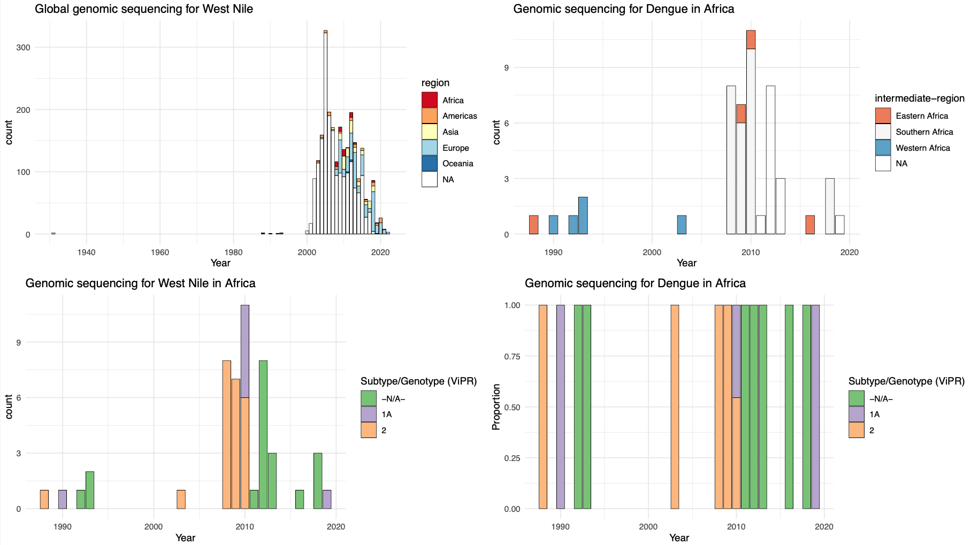
The landscape of genomic surveillance of arboviruses in Africa
West Nile Fever
Africa:
genomes = 191
countries = 15
1958-2020
Quality:
Coverage >90% = 29
Genotyped = 167

Slide 27
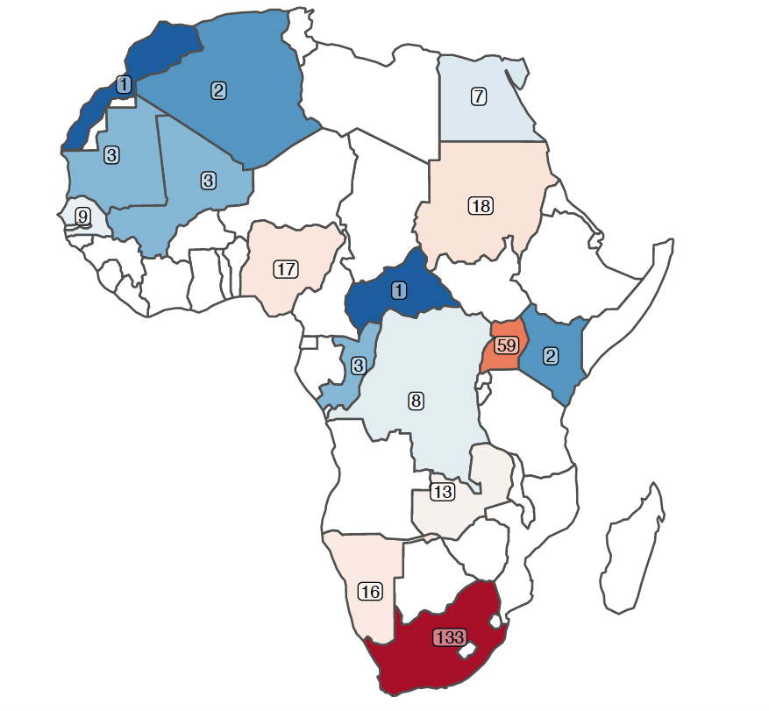
The landscape of genomic surveillance of arboviruses in Africa
Crimean Congo Hemorrhagic Fever
Africa:
genomes = 303
countries = 16
1956-2019

Slide 28
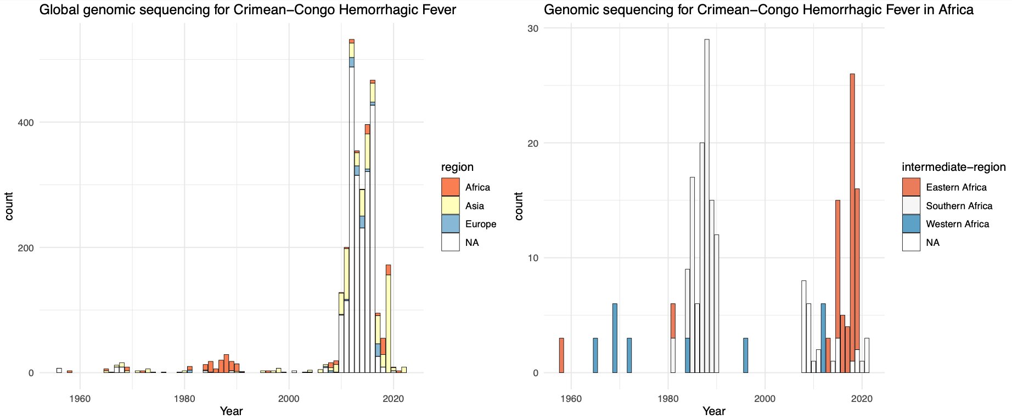
The landscape of genomic surveillance of arboviruses in Africa
Crimean Congo Hemorrhagic Fever
Africa:
genomes = 303
countries = 16
1956-2019

Slide 29
Transmission Dynamics of Arboviruses in Africa

Slide 30
Questions to Answer
What are the levels of importations vs endemicity in Africa?
Are the effective population sizes of the relevant pathogens increasing in Africa? (indicates endemic circulation)
What are the risks of importations of Arboviruses from Asia and Americas?
What are the risks of local transmission/outbreaks/epidemics upon importation?
Do transmission dynamics correlate with environmental factors?

Slide 31
Dengue Phylogenetics & Transmission Dynamics in Africa

Slide 32
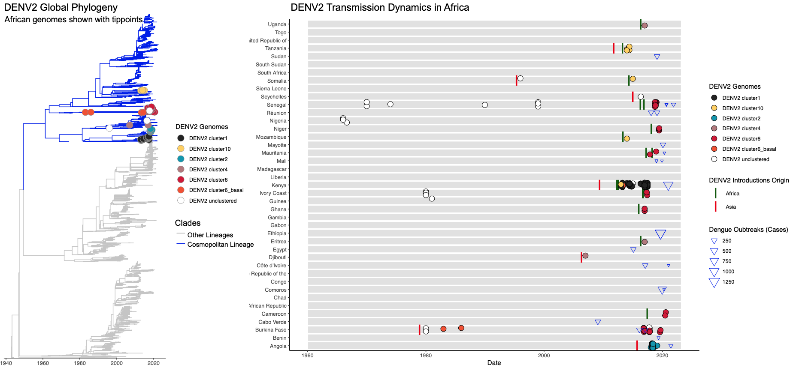
DENV2 - Multiple introductions into Africa - Multiple continental transmission clusters - Evidence of endemic circulation

Slide 33
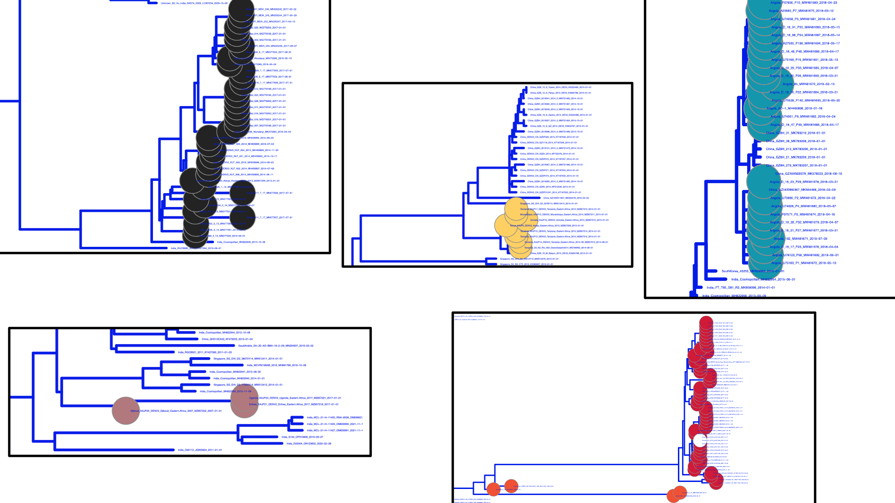
DENV2 - Multiple introductions into Africa - Multiple continental transmission clusters

Slide 34
Next steps
Continue with literature review
Gather datasets from literature review
Complete phylogenetics for selected pathogens (Dengue, Chikungunya, Zika, RVF, Yellow Fever, West Nile, CCHF)
Define levels of importations vs endemicity by mapping outbreak info with phylogenetics clusters
Gather and map all seroprevalence studies against outbreak and genomic data to identify gaps
BEAST Phylodynamics in select countries to understand if effective population size is increasing (indicates endemic circulation)
Quantify risk of importations of Arboviruses from Asia and Americas using mobility data and disease susceptibility data
Correlate outbreaks/phylodynamics with environmental info
Gather and map all published estimates of disease susceptibility modelling and correlate with outbreaks
Expand genome database for Arboviruses in Africa!

